Slide 1
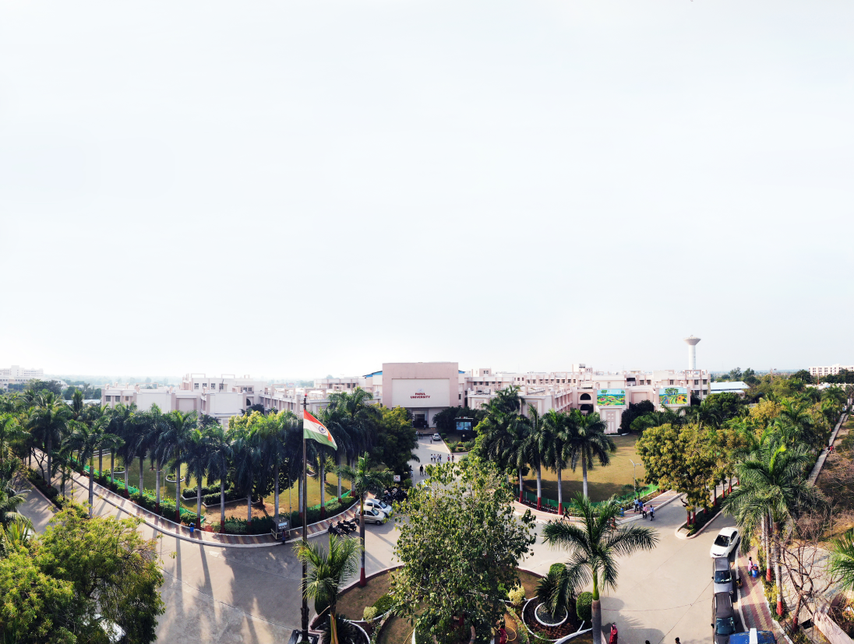


Unit 2
Stacks and queue
Prof. vishwa Dabhi, Assistant Professor
Computer science and Engineering

Slide 2


Topic-2
Queues

Slide 3
Topics Covered
ADT Queue
Types of Queues:
Simple Queue
Circular Queue
Priority Queue
Operations on each types of queues:
Algorithms and their analysis

Slide 4
ADT(Abstract Data Type)
The queue abstract data type is defined by the following structure and operations:
Queue is a linear list of elements in which deletions can take place only at one end called the front and insertions can take place only at the other end called rear.
Queues are also called as FIFO (First In First Out) list.

Slide 5
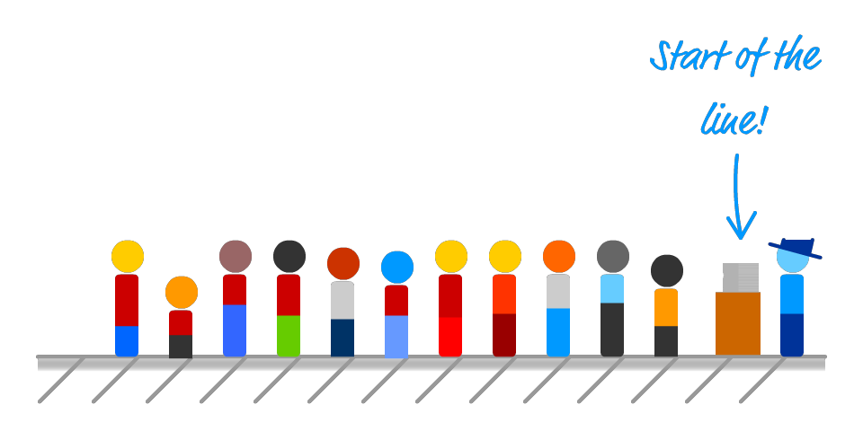
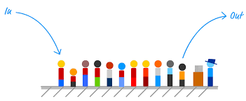
Pictorial Representation of Queue
Image source : Google

Slide 6
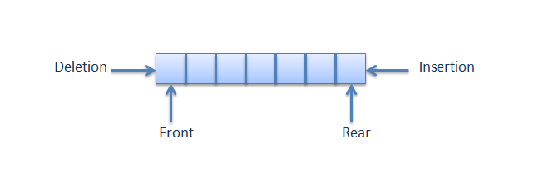
Examples of Queue in day to day life
Railway reservation counter
Movie theatre ticket counter
An Escalator
A Car wash, etc.
Before getting the service, one has to wait in the queue. After getting the service, one leaves the queue.
Service is provided at one end(front/head) and people join at the other end(rear/back/tail).
Image source : Google

Slide 7
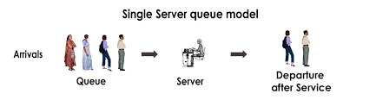
Application of Queues in Computing
Scheduling of processes (Round Robin Algorithm).
Spooling (to maintain a queue of jobs to be printed).
A queue of client processes waiting to receive the service from the server process).
An input stream.
Image source : Google

Slide 8
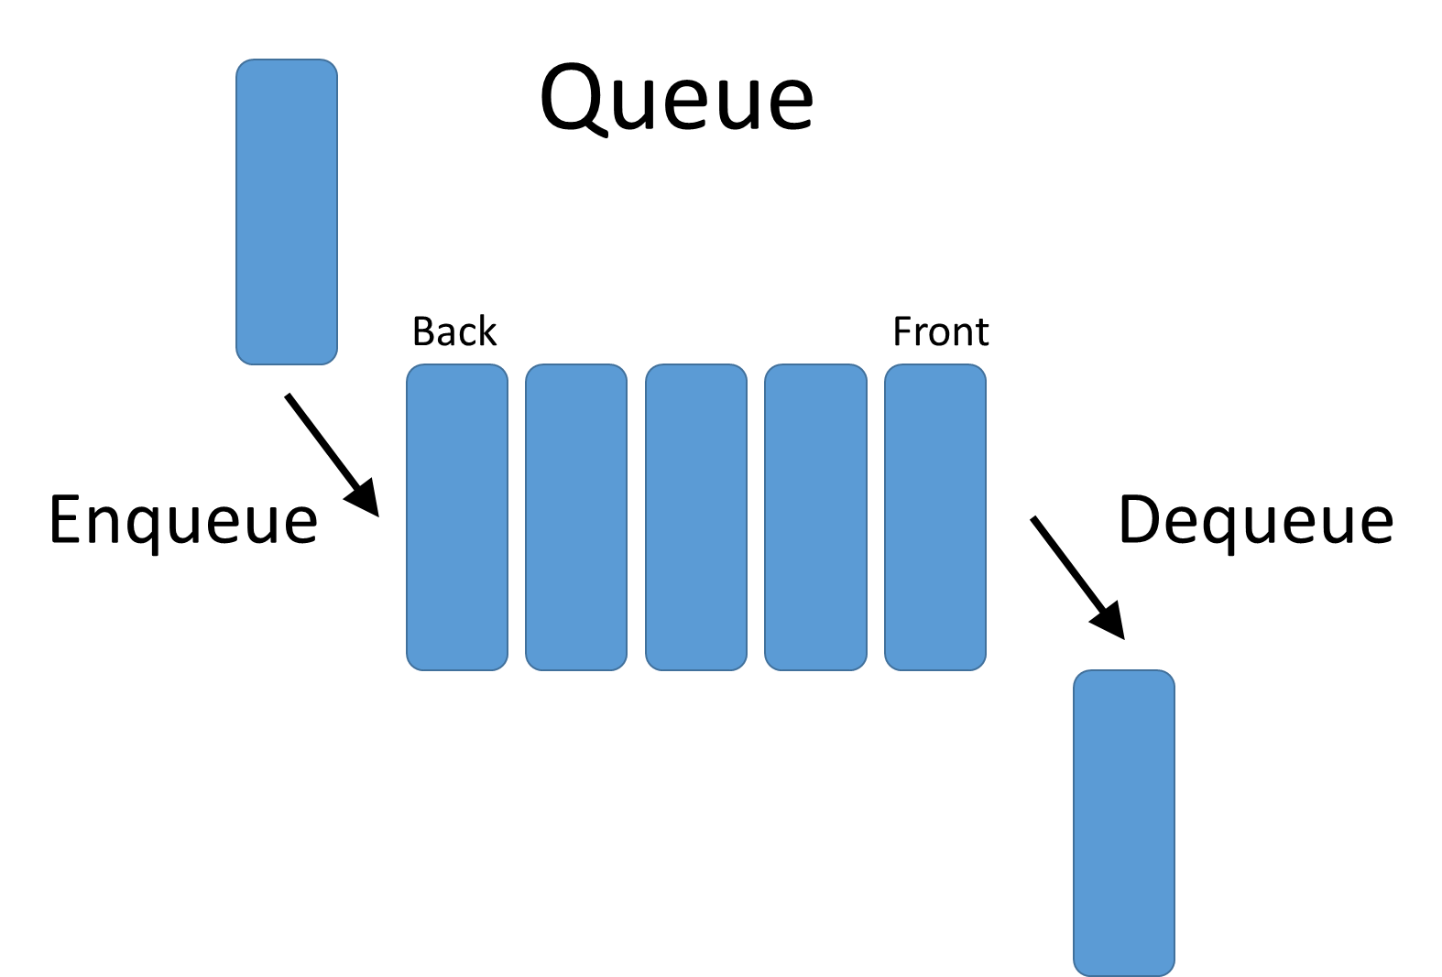
Simple Queue / Linear Queue
Simple queue defines the simple operation of queue in which insertion occurs at the rear of the list and deletion occurs at the front of the list.
Image source : Google

Slide 9
Operations on a queue:
initialize(): Initializes a queue by setting the value of front and rear to -1.
enqueue(): Inserts an element at the rear end of queue.
dequeue()/delete(): Deletes an element from the front end of queue.
empty(): Returns true(1) if queue is empty and returns false(0) otherwise.
full(): Returns true(1) if queue is full and returns false(0) otherwise.
print(): Printing queue elements.

Slide 10
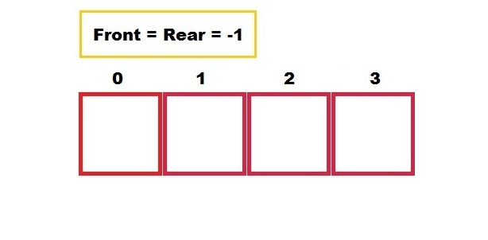
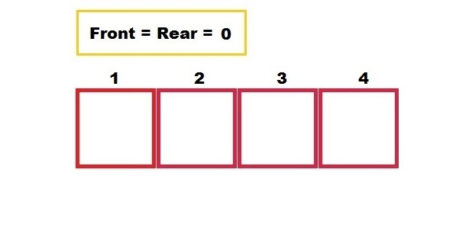
We can perform initialization operation of queue by giving initial value to front and rear pointer in queue by following rules:
Initialize front and rear to 0 if the element starts from 1.
Initialize front and rear to -1 if the element starts from 0.

Slide 11
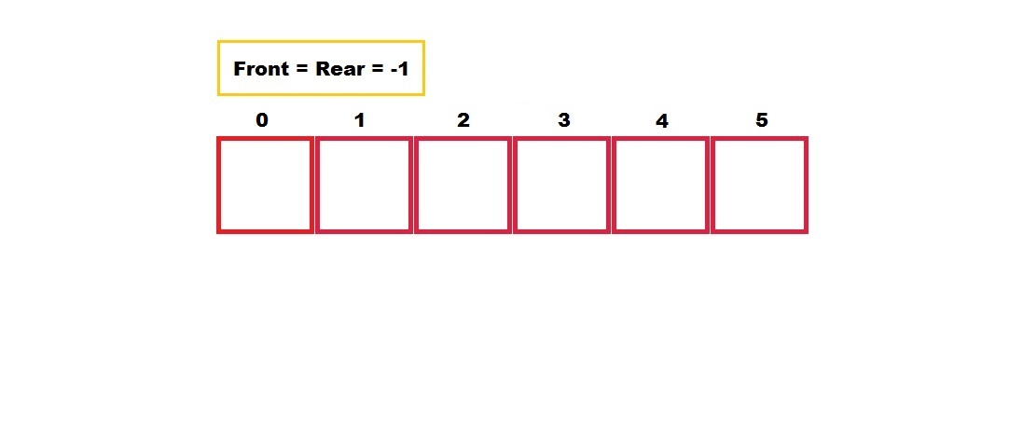
Example of Simple Queue
Empty Queue

Slide 12
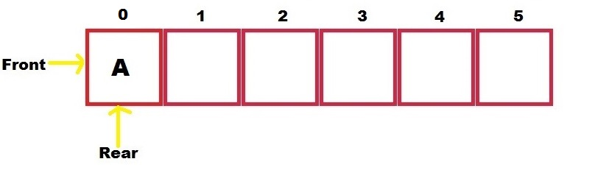
Example of Simple Queue
Non Primitive Data Structure
Insert A

Slide 13
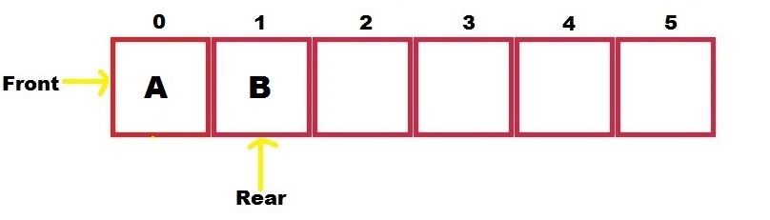
Example of Simple Queue
Non Primitive Data Structure
Insert B

Slide 14
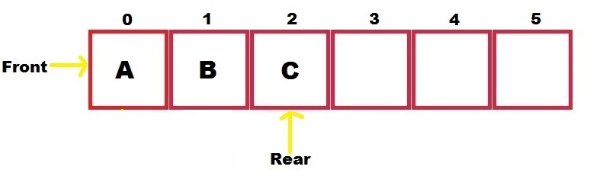
Example of Simple Queue
Non Primitive Data Structure
Insert C

Slide 15
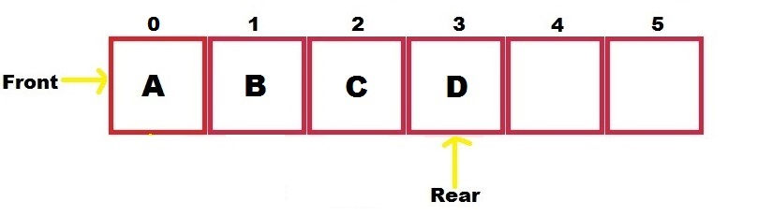
Example of Simple Queue
Non Primitive Data Structure
Insert D

Slide 16
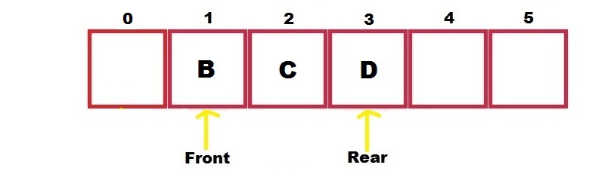
Example of Simple Queue
Non Primitive Data Structure
Delete A

Slide 17
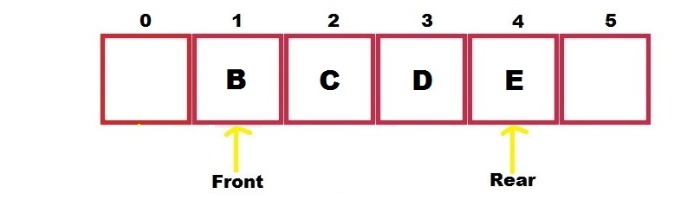
Example of Simple Queue
Non Primitive Data Structure
Insert E

Slide 18
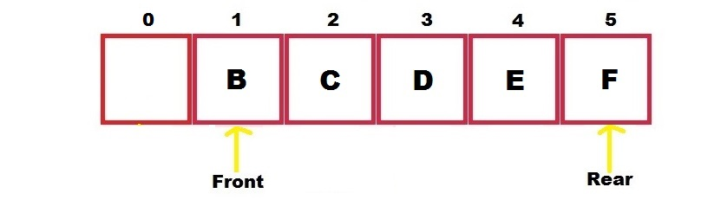
Example of Simple Queue
Non Primitive Data Structure
Insert F

Slide 19
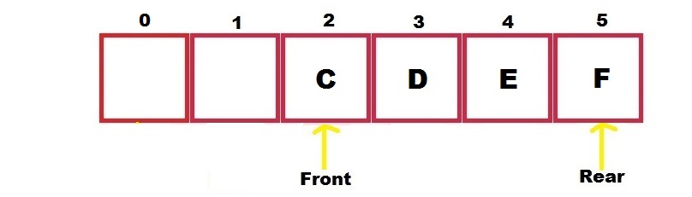
Example of Simple Queue
Non Primitive Data Structure
Delete B

Slide 20
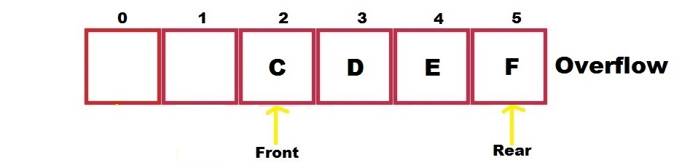
Example of Simple Queue
Non Primitive Data Structure
Insert G
Disadvantage of linear queue is that, in linear queue if the queue is fully occupied and the queue’s initial place is empty and if want to insert other character then it is not possible even though the initial cells are empty.

Slide 21
Algorithms
INSERT(Q, F, R, N, Y)
If R>=N then write: overflow and return
R=R+1
Q[R] = Y
If F==-1 then
F=0 and return
DELETE(Q, F, R)
If F==-1 the write: Underflow and return
Y = Q[F]
If F==R then F=-1 and R=-1 else F=F+1
Return [Y]
Here,
Q = Queue
F = Front
R = Rear
N = Size of Queue
Y = Element or item that can be traced on the queue

Slide 22
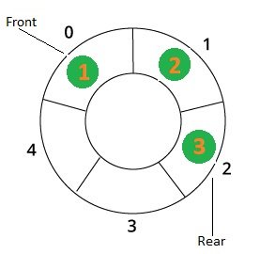
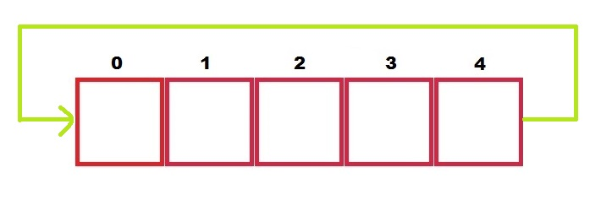
Circular Queue
In a normal Queue, once queue becomes full, we can not insert the next element even if there is a space in front of queue.
The solution to this is, whenever the rear end gets to the end of the array, it should be wrapped around to the beginning of the array.
Now the array can be viewed as a circle where the first position will follow the last element.
Image source : Google

Slide 23
Example of Circular Queue
Empty

Slide 24
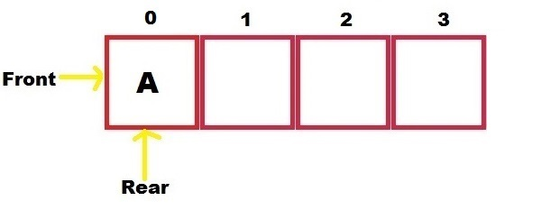
Example of Circular Queue
Insert A

Slide 25
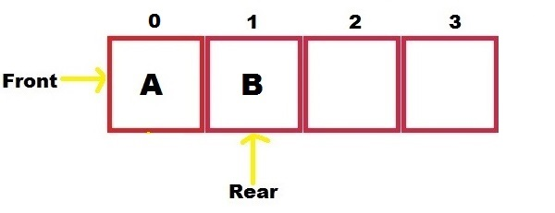
Example of Circular Queue
Insert B

Slide 26
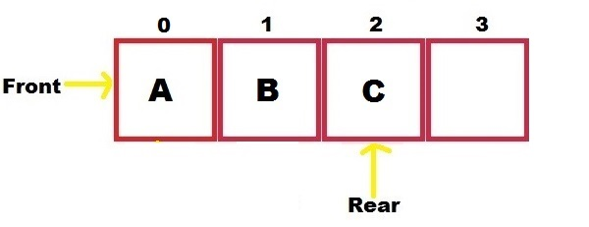
Example of Circular Queue
Insert C

Slide 27
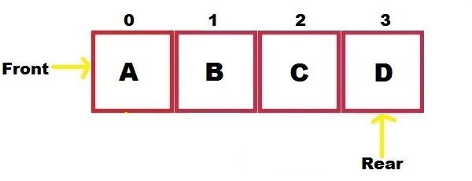
Example of Circular Queue
Insert D

Slide 28
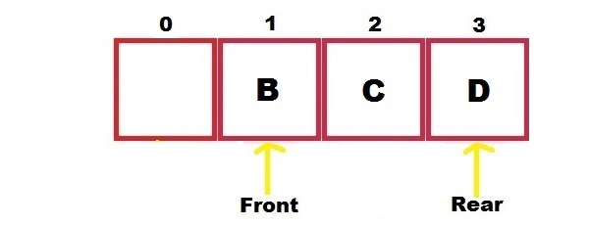
Example of Circular Queue
Delete A

Slide 29
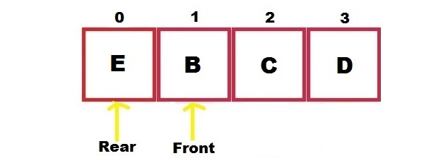
Example of Circular Queue
Insert E

Slide 30
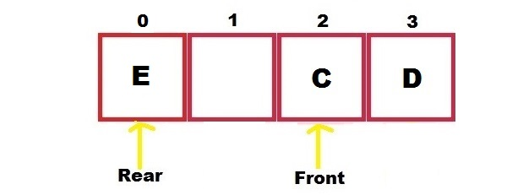
Example of Circular Queue
Delete B

Slide 31
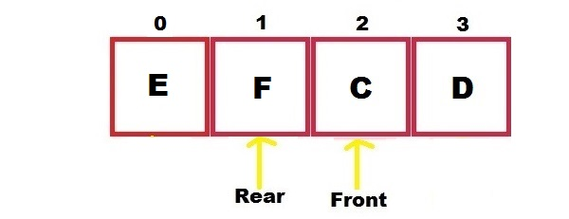
Example of Circular Queue
Insert F

Slide 32
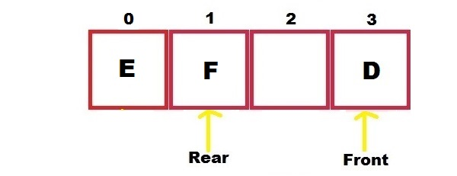
Example of Circular Queue
Delete C

Slide 33
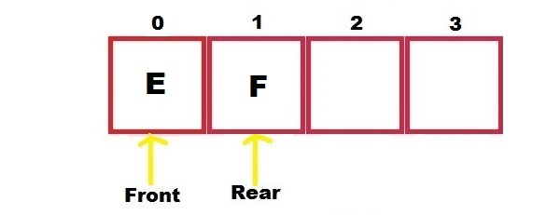
Example of Circular Queue
Delete D

Slide 34
Algorithms
CQINSERT(Q, F, R, N, Y)
If R==N then R=0 else R=R+1
If R=F-1 then write: Overflow and return
Q[R] = Y
If F==-1 then
F=0 and return
CQDELETE(Q, F, R, N)
If F==-1 the write: Underflow and return
Y = Q[F]
If F==R then F=-1 and R=-1 and return [Y]
If F==N then F=0 else F=F+1 and return[Y]
Here,
Q = Queue
F = Front
R = Rear
N = Size of Queue
Y = Element or item that can be traced on the queue

Slide 35
Dequeue
Dequeue is the short notation used for double ended queue.
The usual practice is: for insertion of element we use one end called rear and for deletion of elements we use front end.
In dequeue we make use of both the ends for insertion of the elements as well as we can use both the ends for deletion of the elements.
In simple words, it is a linear list in which elements can be added or removed from either ends but not in the middle.

Slide 36
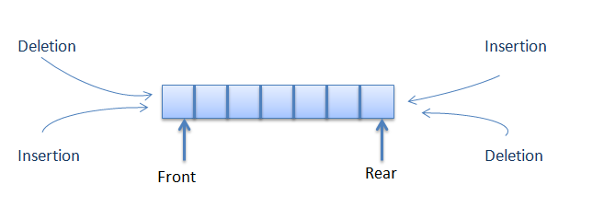
Structure of Dequeue
Image source : Google

Slide 37
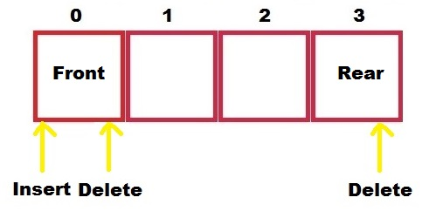
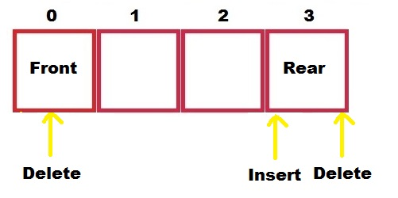
Classification of Dequeue
Input Restricted:
When we use only one end for inserting an element and both the ends for deleting an element.

Slide 38
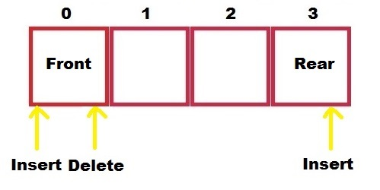
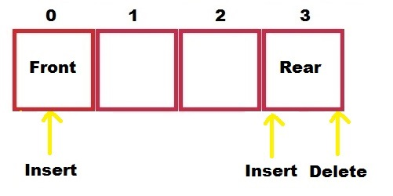
Classification of Dequeue
Output Restricted
When we use only one end for deleting an element and both ends for insertion of an element.

Slide 39
Methods to implement Dequeue
Using circular array
Using singly linked list
Using doubly linked list
Using singly circular linked list
Using doubly circular linked list

Slide 40
Operations on dequeue
initialize():Make the empty queue.
empty(): To check whether queue is empty or not.
full(): To check whether queue is full or not.
enqueueF(): To insert an element to the front end of the queue.
enqueueR(): To insert an element to the rear end of the queue.
dequeueF(): Delete the front element.
dequeueR(): Delete the rear element.
print(): Print elements of queue.

Slide 41
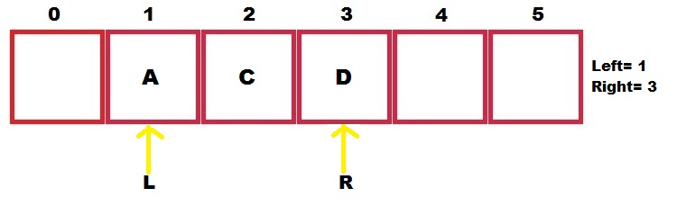
Example of Dequeue
Consider the following dequeue of characters where dequeue is a circular array which is allocated 6 memory cells.
Left=1 and Right =3.
Dequeue: _,A,C,D,_,_.

Slide 42
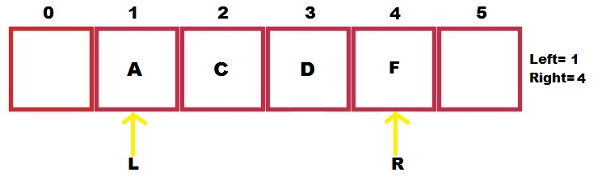
Example of Dequeue
F is added to right of dequeue

Slide 43
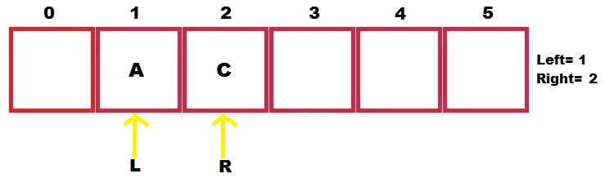
Example of Dequeue
2 letters are deleted from right.

Slide 44
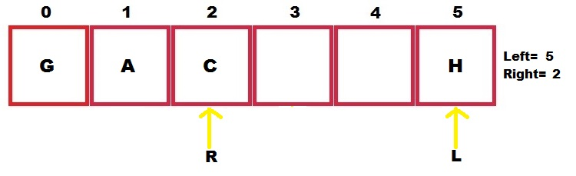
Example of Dequeue
G, H are added to left of dequeue.

Slide 45
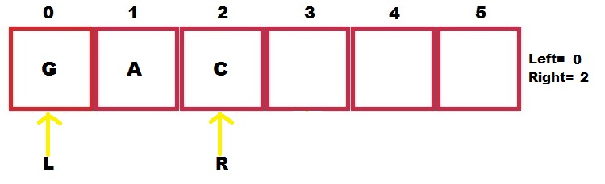
Example of Dequeue
1 letter is deleted from left

Slide 46
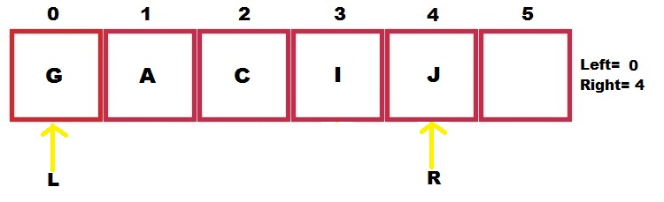
Example of Dequeue
I, J are added to right of dequeue

Slide 47
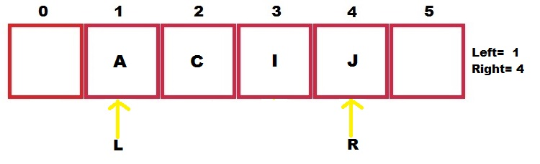
Example of Dequeue
1 letter is deleted from left

Slide 48
Priority Queue
It is a collection of elements such that each element has been assigned a priority and the order in which elements are processed and deleted follows following rules:
An element with higher priority is processed before any element with lower priority.
Two elements with same priority are processed on FCFS (First Come First Serve) basis.

Slide 49
Operations on priority queue
initialize(): Make the empty queue.
full(): Check if the queue is full or not.
empty(): Check if the queue is empty or not.
enqueue(): Insert an element as per its priority.
dequeue(): Delete the element in front(as front element has the highest priority).
print(): Print queue elements.

Slide 50
Types/Representation of priority queue
1) One way list representation of a priority:
Each node in a list will contain 3 items of an information: INFO(), PRIORITY_NO() and a link.
A node X precedes node Y in the list where:
1. X has higher priority than Y.
2. When both have same priority but X was added in the list before Y.

Slide 51
Algorithm
INSERT
It adds an item with priority number ‘n’ to a priority queue which is maintained in memory as one-way list.
Traverse one- way list until you find a node X whose priority number exceeds ‘n’.
Insert ITEM in front of node X.
If no such element is found, insert ITEM as the last element of the list.

Slide 52
Algorithm
DELETE
It deletes and processes the first element in a priority queue which appears in memory as one-way list.
Set ITEM=INFO[START]
Delete first node from the list
Process ITEM
Exit

Slide 53
Types/Representation of priority queue
2) Array Representation of Priority Queue:
Another way to maintain priority queue is to use a separate queue for each level of priority.
Each such queue will appear in its own circular array and must have its own pair of pointers (rear and front).
In each queue is allocated same amount of space, a 2D array of queue can be used instead of linear arrays.

Slide 54
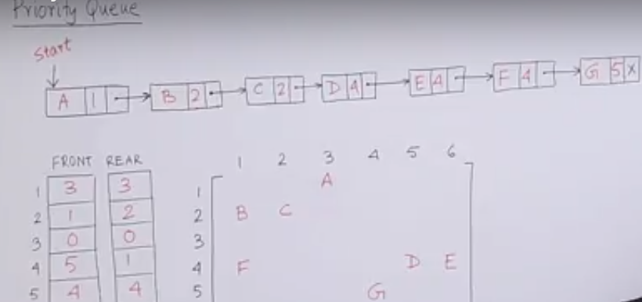
Types/Representation of priority queue
2) Array Representation of Priority Queue:

Slide 55
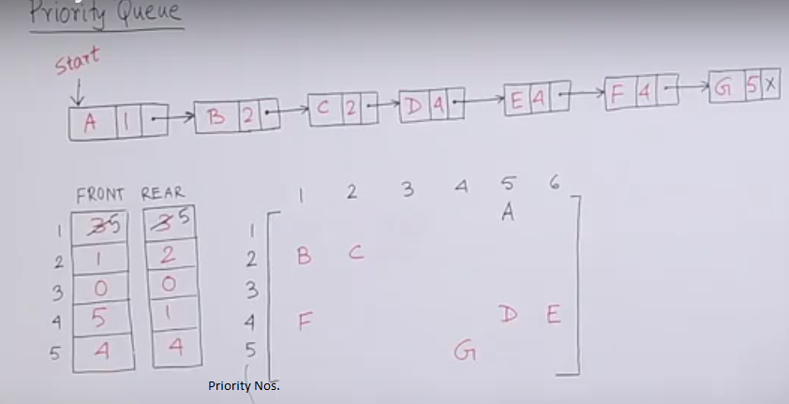
Types/Representation of priority queue
2) Array Representation of Priority Queue:

Slide 56
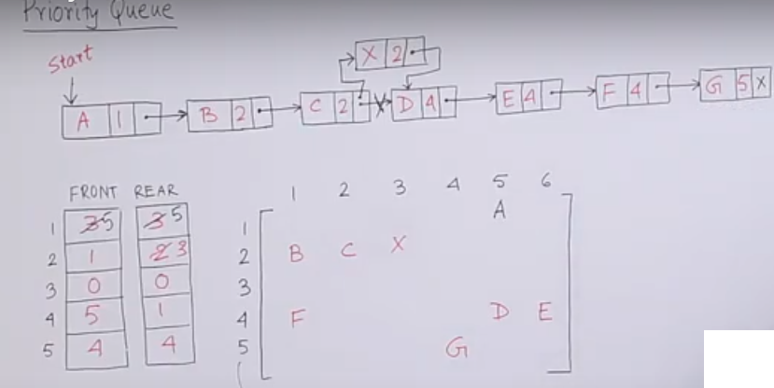
Types/Representation of priority queue
2) Array Representation of Priority Queue:

Slide 57
Implementation of priority queue
Implementation with an unsorted list
Performance:
insert takes O(1) time since we can insert the item at the beginning or end of the sequence
remove take O(n) time since we have to traverse the entire sequence to find the smallest key
Implementation with a sorted list
Performance:
insert takes O(n) time since we have to find the place where to insert the item
remove and take O(1) time, since the smallest key is at the beginning
4
5
2
3
1
1
2
3
4
5

Slide 58


www.paruluniversity.ac.in

